Slide 1

Basic Details of the Team and Problem Statement
Ministry/Organization Name/Student Innovation:
Government of Himachal Pradesh
PS Code: SIH1383
Problem Statement Title: Optimizing Doctor Availability and Appointment Allocation in Hospitals through Digital Technology and Al Integration.
Team Name: Stalwarts
Team Leader Name: Jayanth Gudimella
Institute Code (AISHE): C-25622
Institute Name: Chaitanya Bharathi Institute of Technology, Hyderabad
Theme Name: Med/Bio/HealthTech

Slide 2
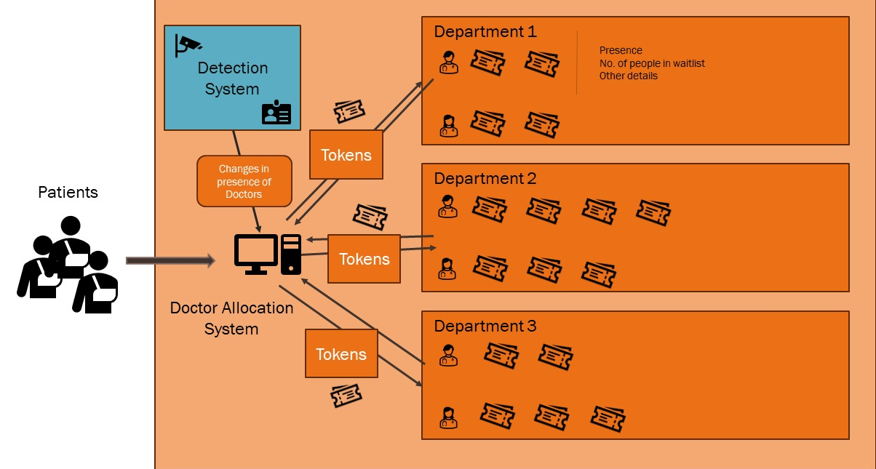








Idea/Approach Details
Diagram representing the system:
Describe your idea/Solution/Prototype here:
Patients are given appointment tokens based on their needs and the availability of doctors.
Algorithm finds the doctor for a patient such that waiting time is minimized
A backend API service provided the current state and accepts requests to add new patients, end sessions etc.,
The details of doctors, patients, departments and tokens are stored and read from database while also maintaining a fast-access alternative in-memory structure.
Describe your Technology stack here:
Python – Tkinter, PyMongo driver, Flask
Plans for shifting to JavaScript and TypeScript – React JS, MongoDB NodeJS driver, Express JS with Nest JS Architecture, Prisma for modelling DB

Slide 3
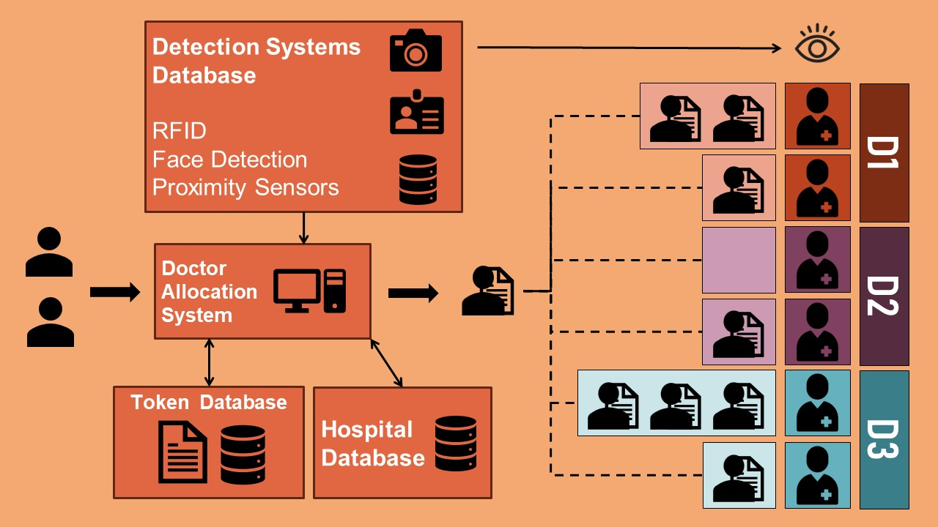
Idea/Approach Details
Diagram representing the system:
Describe your idea/Solution/Prototype here:
Patients are given appointment tokens based on their needs and the availability of doctors.
Algorithm finds the doctor for a patient such that waiting time is minimized
A backend API service provided the current state and accepts requests to add new patients, end sessions etc.,
The details of doctors, patients, departments and tokens are stored and read from database while also maintaining a fast-access alternative in-memory structure.
Describe your Technology stack here:
Python – Tkinter, PyMongo driver, Flask
Plans for shifting to JavaScript and TypeScript – React JS, MongoDB NodeJS driver, Express JS with Nest JS Architecture, Prisma for modelling DB

Slide 4
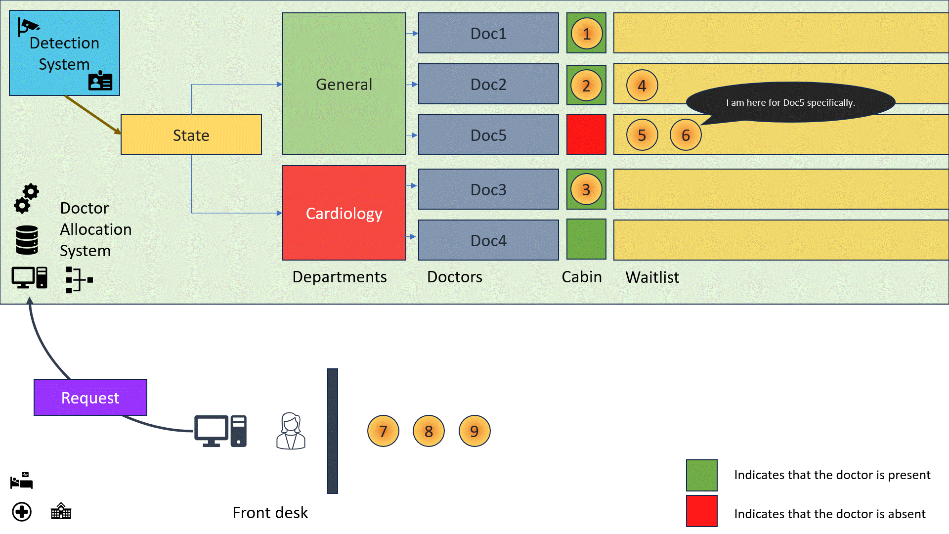
Idea/Approach Details
Describe your use cases here
Dependencies:
The system relies on the hospitals infrastructure for doctor detection.
Needs to know about all the doctors and special schemes and schedules to operate effectively.

Slide 5
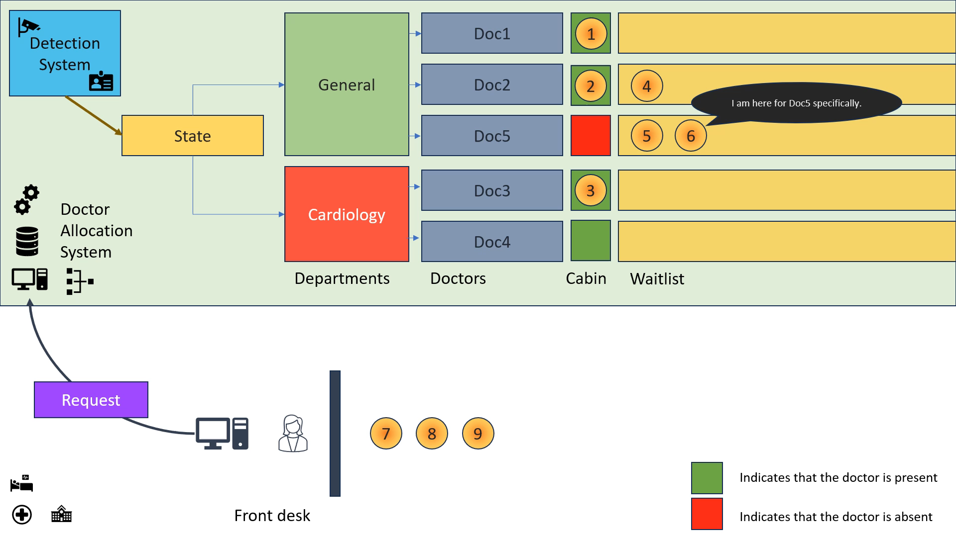
Idea/Approach Details
Describe your use cases here
Dependencies:
The system relies on the hospitals infrastructure for doctor detection.
Needs to know about all the doctors and special schemes and schedules to operate effectively.

Slide 6
Team Member Details
Team Leader Name: Jayanth Gudimella
Branch (Btech/Mtech/PhD etc): BE Stream (ECE, CSE etc): AI&DS Year (I,II,III,IV): II
Team Member 1 Name: Param Gholap
Branch (Btech/Mtech/PhD etc): BE Stream (ECE, CSE etc): AI&DS Year (I,II,III,IV): II
Team Member 2 Name: Karath Vamsi V
Branch (Btech/Mtech/PhD etc): BE Stream (ECE, CSE etc): AI&DS Year (I,II,III,IV): II
Team Member 3 Name: C Ruthvik Varma
Branch (Btech/Mtech/PhD etc): BE Stream (ECE, CSE etc): AI&DS Year (I,II,III,IV): II
Team Member 4 Name: Sairam Reddy
Branch (Btech/Mtech/PhD etc): BE Stream (ECE, CSE etc): AI&DS Year (I,II,III,IV): II
Team Member 5 Name: N. Pravalika
Branch (Btech/Mtech/PhD etc): BE Stream (ECE, CSE etc): AI&DS Year (I,II,III,IV): II
Team Mentor 1 Name: Type Your Name Here
Category (Academic/Industry): Expertise (AI/ML/Blockchain etc): Domain Experience (in years):
Team Mentor 2 Name: Type Your Name Here
Category (Academic/Industry): Expertise (AI/ML/Blockchain etc): Domain Experience (in years):

